Slide 1
Budget Management App: Outcomes and Lessons Learned
Andy, Ali, Joon, Anna, Na, Jack

Slide 2
Project Overview
Customer: UW-Credit Union
Purpose of the project
allow users to keep track of their income, expense, and remaining balance
alert them if they spend excessive amounts of money
Goal of the project
help people who have less experience on managing budgets or struggle to control their spending habits
Notes:
Project overview
The money management application does not only allow users to keep track of their income, expense, and remaining balance, but also alert them if they spend excessive amounts of money on a certain category. The goal of the application is to help people who have less experience on managing budgets or struggle to control their spending habits. The application provides features in account books such as tracking income, expense, and balance. Additionally, the application can remind a user when he or she tries to spend excessively by sending a notification.
Frontend: MainPage, Categories, Goals, Report, Settings
MainPage
The main page displays right after the user logs in.
Can add transactions
View Monthly expenses vs. Monthly Budget
Categories
The categories page displays all the user’s current categories along with their budgets.
The user is also able to add and delete categories here.
Goals
The goals page breaks down each category budget vs. how much the user has spent this month in that category.
The progress is displayed in progress bars.
Report
The report page allows the users to view past spending trends. The user is able to select a start and and end date and then a bar graph and pie graph are generated to show both the user’s spending trends as well as how much they’ve spent per category.
Settings Page
The settings page allows the user to do things like update account information
Learn how to use the app through the user guide
Access the tip and tax calculator
Logout of the app.
Backend: Server/Client and Database:
Server:
Java Socket Server
We ran a java socket server locally on a specified port.
Server would connect locally using the MySQL Driver to the database.
Client:
Communicated to the Server via Print Writers
Strings would be send to the server, parsed, and the server would receive the message and parse it to get it’s data.
Database:
MySQL database running locally on our computers.
Used MySQL Workbench to be able to see different Databases and Tables
Organization:
There is one user database that contains all of the users information and after it’s validated another database is created with all of the user’s Budget information.

Slide 3
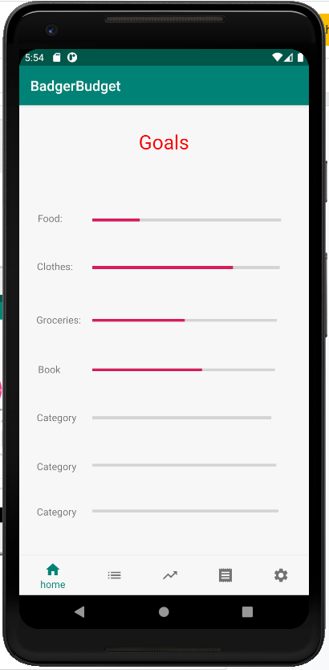
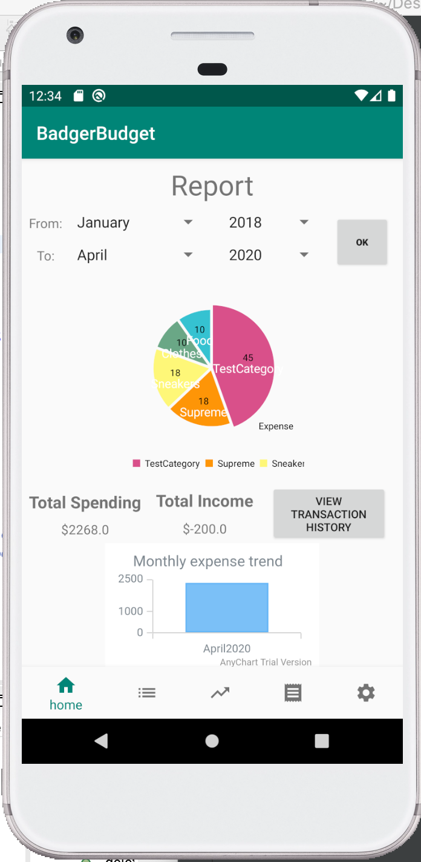
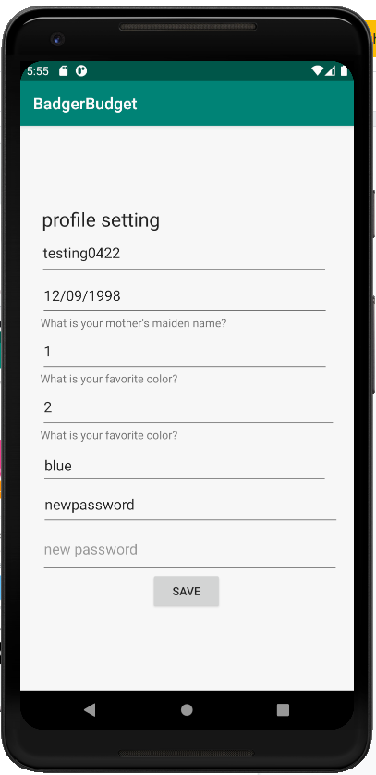
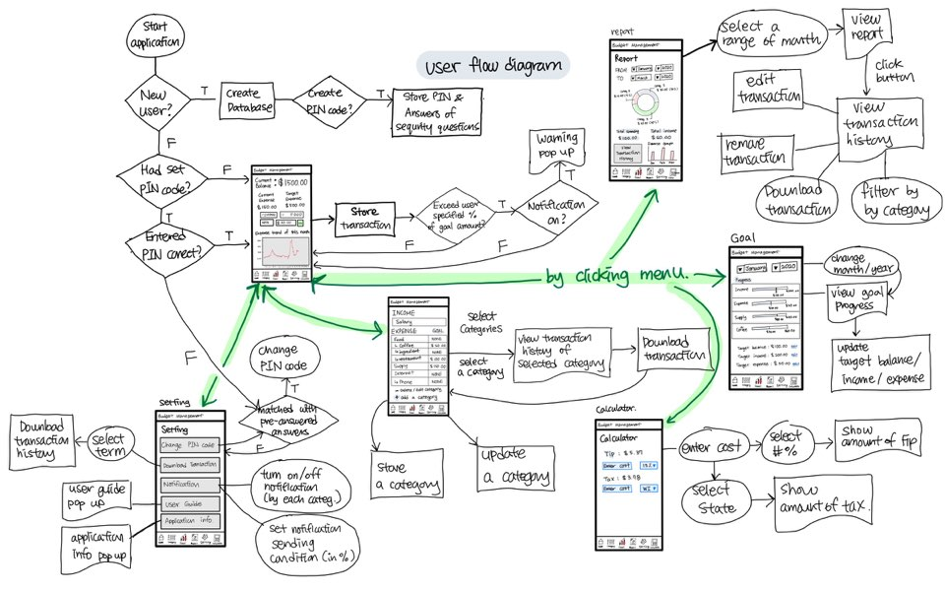
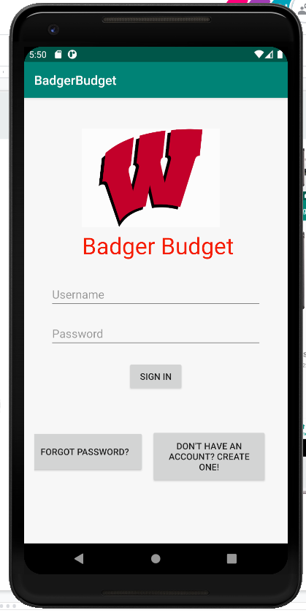
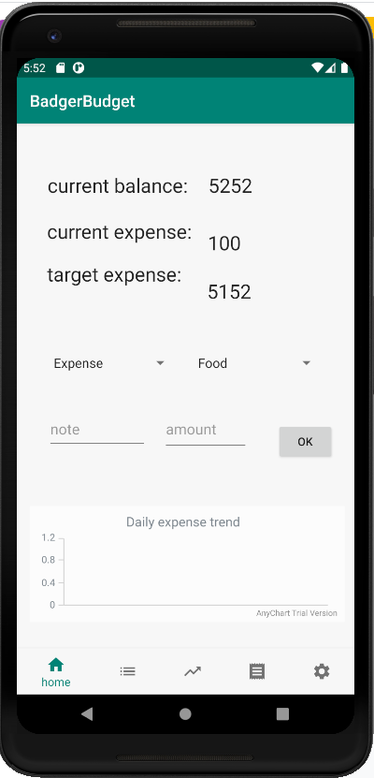
Specification & Design
User Interface
Initial specification diagram & UI

Slide 4
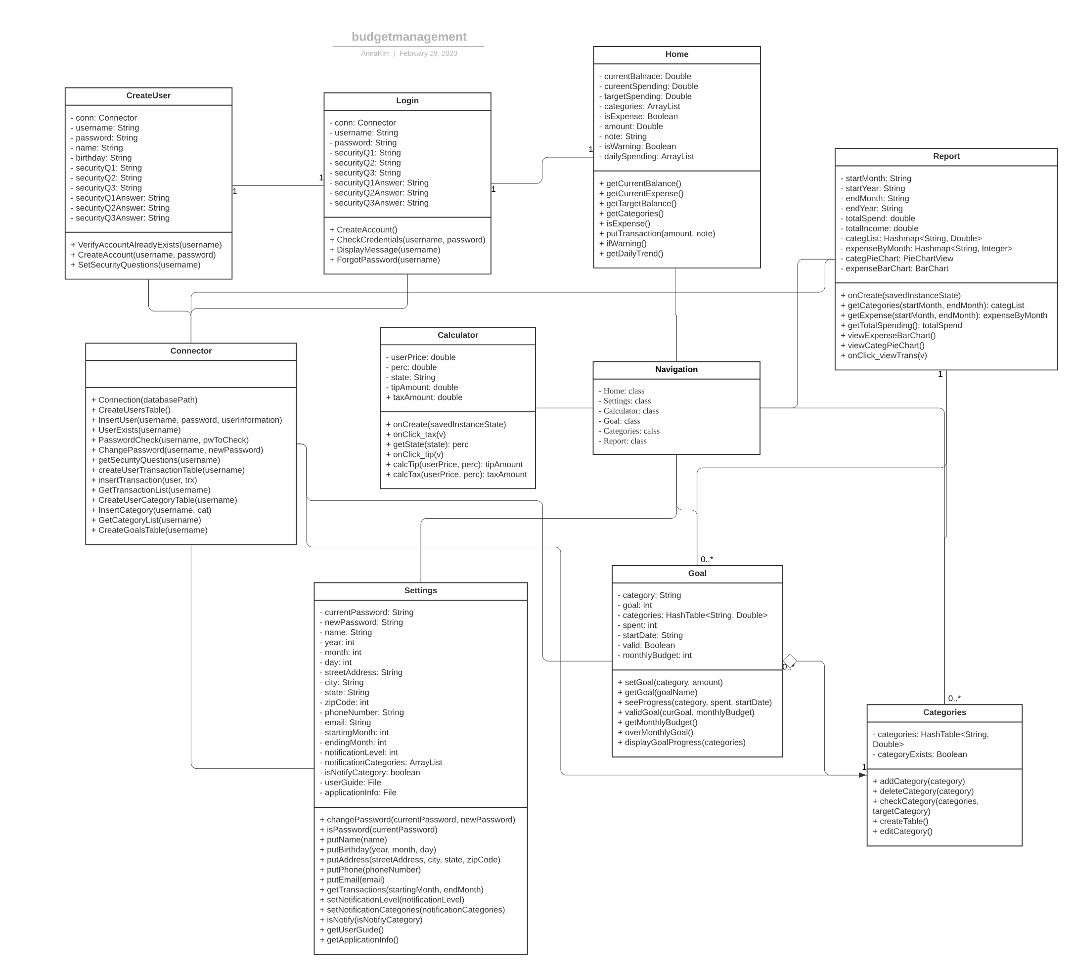
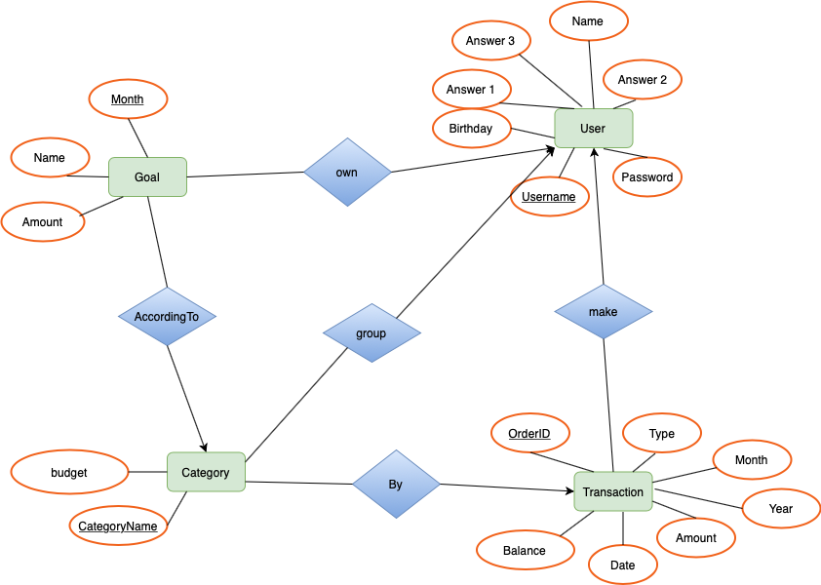
Specification & Design
Class Diagram
ER Diagram

Slide 5
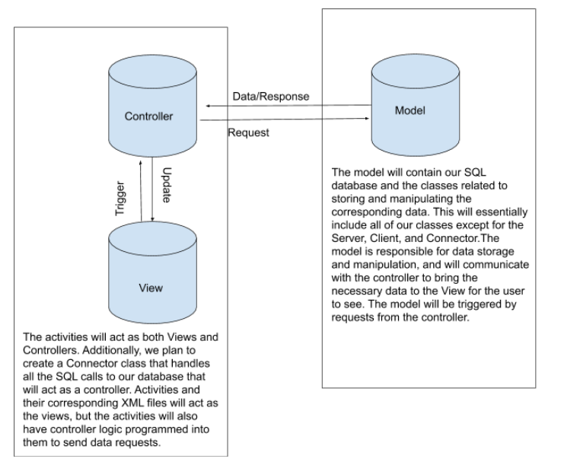
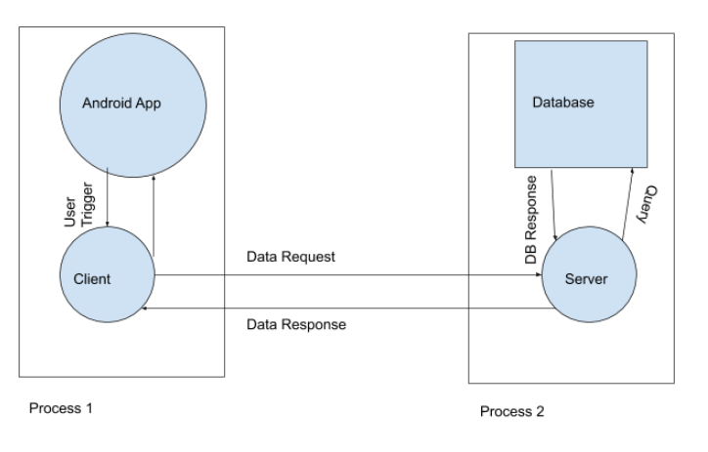
System Design
(MVC Design)
System Design (MVC Design)
Notes:
MVC:
Model: Backend Server
View: User Interface
Controller: Connector class for front-end and back-end

Slide 6
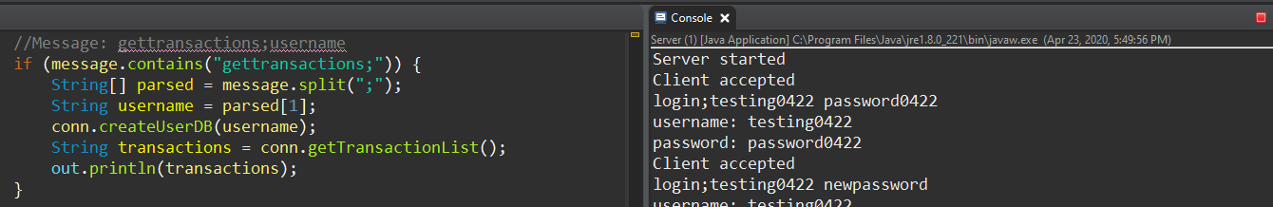
Project Progress up to this point
Server/Client connection working with Android Studio frontend
Backend functionalities that meets our specification & design
Login functionality
Create account functionality
Add transaction functionality
Add/delete Categories
View Report / Goal
Can change account settings
…
Notes:
Progress So Far:
We have a fully functioning backend that communicates data to the frontend and displays it for the user to view.
The user is fully able to:
Create an Account
Log in
Add Transactions
Add personalized user categories
View current goals progressed
View reports of spending trends both totally as well as per category
Update account information such as password and name.

Slide 7
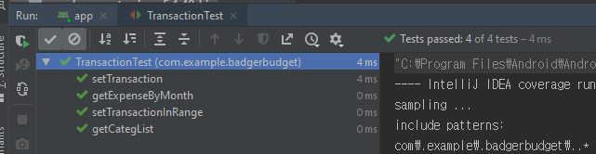
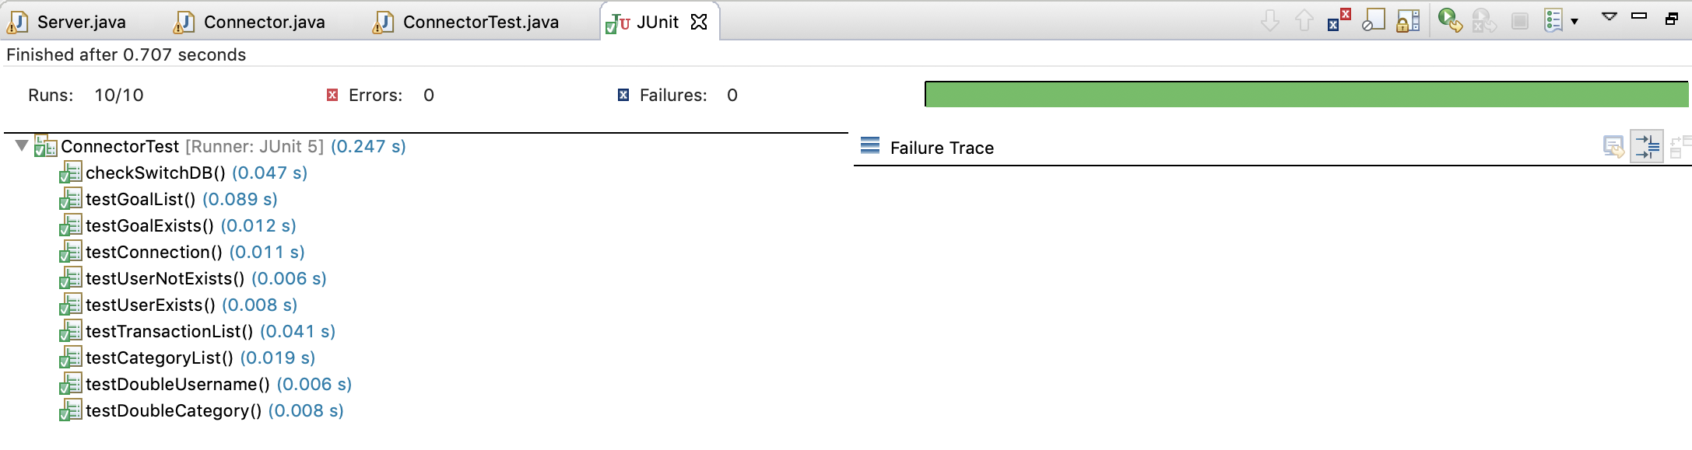
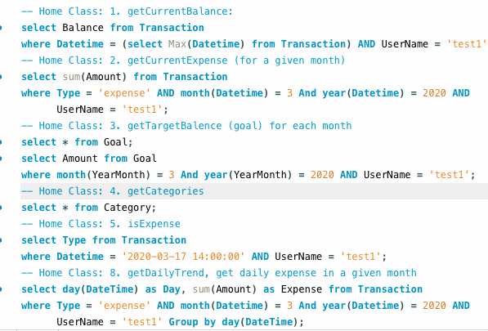

Testing
Backend features
JUnit test with code coverage on Android Studio
Regression Testing
Database
Testing queries before use them
Server/Client
JUnit test with code coverage
Regression Testing
Other tests...
Integration testing
System testing
Notes:
Back-end Testing
Used JUnit testing to show
That the server can successfully connect to the database
The correct tables and databases are created upon creating a user
That the right information was return to the client from the server from the database
That the username and password match that of what is currently stored in the database.
The things like username and categories aren’t able to be repeated.

Slide 8
What went wrong (what was not accomplished)
What Went Wrong:
Remote coding adjustment period
Server/Client Issues
Connecting to Front-end to Back-end
Still To Do:
Fix Bugs
System testing, Regression testing etc. with sample dataset
Automated testing
Reaching 85% code coverage
Make UI look better
Notes:
What Went Wrong:
Took a little to adjust to not being able to meet in person.
Harder to keep up with what everyone was doing and when we could meet with us all being in different time zones.
As far as Client/Server/Database operations, our group had little experience and it definitely showed; however, we pulled through.
Client and Server had some issues being able to communicate as well as getting the server to fetch information from the database.
A lot of small bugs that crashed the app
Client on main thread. To solve, client threads were placed in the background
Client had to use local emulator IP address, which we now know is “10.0.2.2”.
Forgot to close socket on the client, which caused the app to hang up badly and black screen.
Connecting the front-end and back end was a little tedious and took longer than expected.
Making the connection between database tables by parsing Strings took a long time

Slide 9




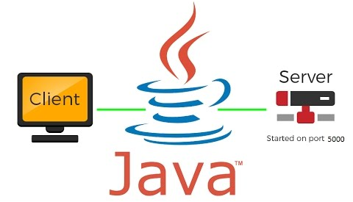
Skills/Tools Learned
Android application development
Version Control
JUnit testing with code coverage
Java Socket Server connected with SQL database

Slide 10
Lessons Learned
Professor TLW was right! “Always take longer than expected”
We developed our technical skills in different fields than we were used to
Working as a team with constant communication
Notes:
Like tlw said, things will always take longer than we expected → as such we should have prepared more and potentially been ready for hiccups like these in the development process
Frontend was done by people without much frontend experience, backend was the same but vice versa, and none of us had real server/client programming experience. As such, we had some challenges in development, but feel like we got the most out of project

Slide 11
Questions?

